Slide 1

TW project: TicTacToe – Overview
Menu
Human vs Human
Random AI vs Random AI
Human vs Random AI
Human vs Unbeatable AI
Human vs Beatable AI
Unbeatable AI vs Unbeatable AI
Board
Empty Board ()
Display Board (board, mode)
Full Board (board)
Game Win (board)
Coordinates
Human user input / Player Move
Random AI
Beatable AI
Unbeatable AI
How good is AI
Gameplay Tic Tac Toe
Quit
Player wins / It’s a tie
Change Player
Coordinates (mode, player)
Statistics AI’s
AI vs AI (different constellations)
Comparison
Conclusion
?
Friday, November 18th 2022
Slide <number>
Zinaida Jusufovic
Thomas Sicay

Slide 2
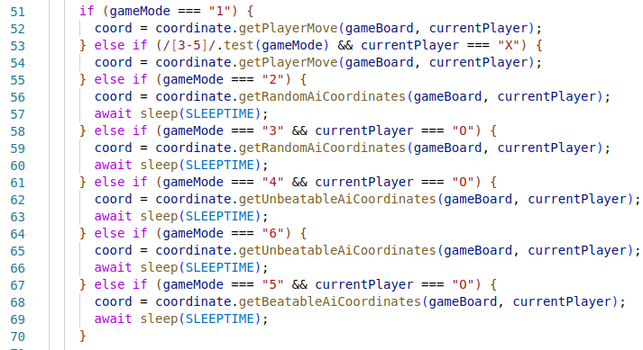
TW project: TicTacToe – Code GamePlay Loop
Game Mode | Player X | Player O
1 | Human | Human
2 | AI Random | AI Random
3 | Human | AI Random
4 | Human | AI Unbeatable
5 | Human | AI Beatable
6 | AI Unbeatable | AI Unbeatable
Friday, November 18th 2022
Slide <number>
Zinaida Jusufovic
Thomas Sicay

Slide 3
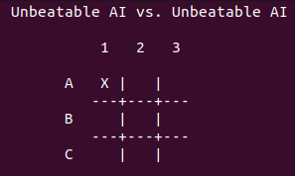
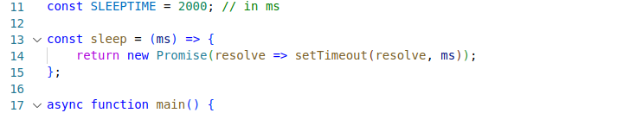
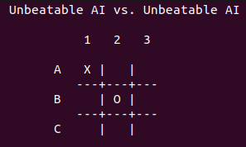
TW project: TicTacToe – Code GamePlay Loop
Wait… 2000 ms
.
.
.
Friday, November 18th 2022
Slide <number>
Zinaida Jusufovic
Thomas Sicay

Slide 4
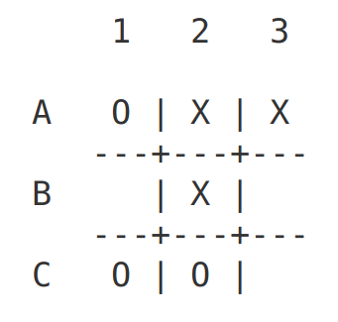
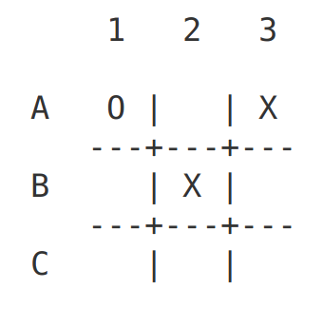
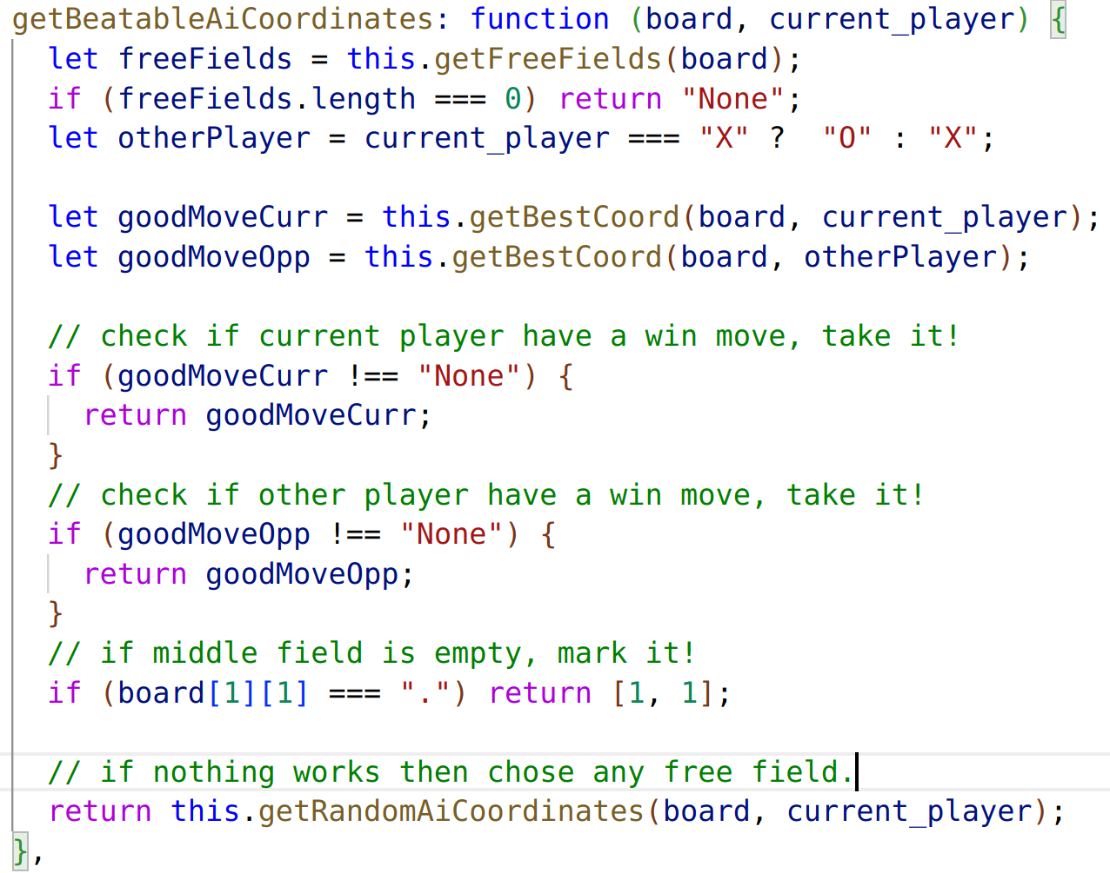
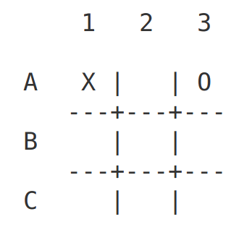
TW project: TicTacToe – Beatable Algorithm
Friday, November 18th 2022
Slide <number>
Zinaida Jusufovic
Thomas Sicay

Slide 5
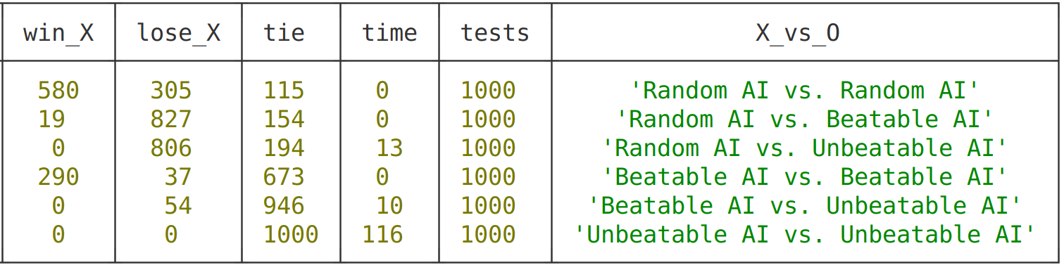
TW project: TicTacToe – Comparison
Friday, November 18th 2022
Slide <number>
Zinaida Jusufovic
Thomas Sicay

